Slide 1
Mehran S. Fallah
November 2020
Game Theory
Games in Strategic (Normal) Form:
Maxmin and Minmax Strategies

Slide 2
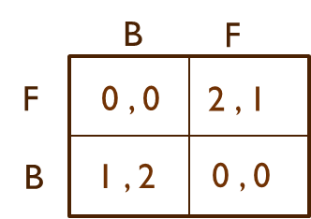







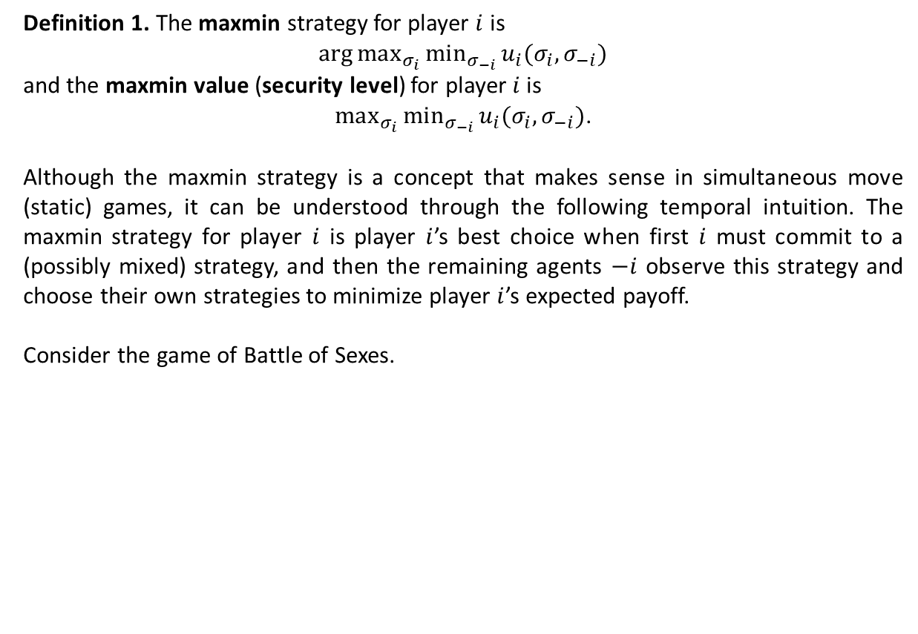



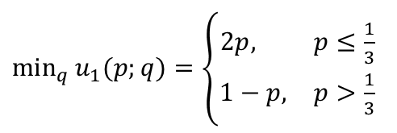





Maxmin Strategies
Definition 1. The maxmin strategy for player $i$ is
$\arg{max_{σ_{i}}{min_{σ_{−i}}{u_{i}(σ_{i},σ_{−i})}}}$
and the maxmin value (security level) for player $i$is
$max_{σ_{i}}{min_{σ_{−i}}{u_{i}(σ_{i},σ_{−i})}}$.
Although the maxmin strategy is a concept that makes sense in simultaneous move (static) games, it can be understood through the following temporal intuition. The maxmin strategy for player $i$ is player $i$’s best choice when first $i$ must commit to a (possibly mixed) strategy, and then the remaining agents $−i$ observe this strategy and choose their own strategies to minimize player $i$’s expected payoff.
Consider the game of Battle of Sexes.
$$q$$
$$1−q$$
$$p$$
$$u_{1}\left(p;q\right)=2p\left(1−q\right)+\left(1−p\right)q$$
$$1−p$$
$$=2p+\left(1−3p\right)q$$
$min_{q}{u_{1}(p;q)}$
$min_{q}{u_{1}(p;q)}=\left\{\begin{matrix}2p, & p≤\frac{1}{3} \\ 1−p, & p>\frac{1}{3}\end{matrix}\right.$
$$2/3$$
$$1/3$$
$\arg{max_{p}{min_{q}{u_{1}(p;q)}}}=\frac{1}{3}$
${\max_{p}{min}}_{q}{u_{1}(p;q)}=\frac{2}{3}$
$${{=max}_{q}{min}}_{p}{u_{2}(p;q)}$$
$$p$$
$$1/3$$
$$1$$

Slide 3








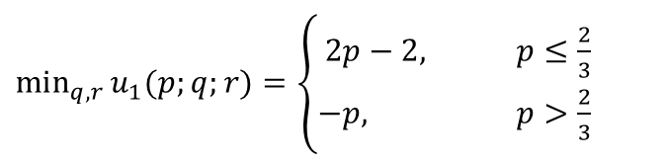







Minmax Strategies (Ctd.)
As another example, consider the following three-player game.
L
R
L
R
U
$$1, 0, −1$$
$$0, −1, 0$$
U
$$−1, 2, 2$$
$$0,−1, 0$$
D
$$0, 1, 2$$
$$−2, 1, 0$$
D
$$0, −1, 0$$
$$0 ,0, 2$$
A
B
$$u_{1}\left(p;q;r\right)=2r\left(q+p−1\right)−pq$$
$min_{q,r}{u_{1}(p;q;r)}$
$$2/3$$
$min_{q,r}{u_{1}(p;q;r)}=\left\{\begin{matrix}2p−2, & p≤\frac{2}{3} \\ −p, & p>\frac{2}{3}\end{matrix}\right.$
$$1$$
$$p$$
$$−2/3$$
$\arg{max_{p}{min_{q,r}{u_{1}(p;q;r)}}}=\frac{2}{3}$
$$−1$$
${\max_{p}{min}}_{q,r}{u_{1}(p;q)}=\frac{−2}{3}$
$$−2$$

Slide 4
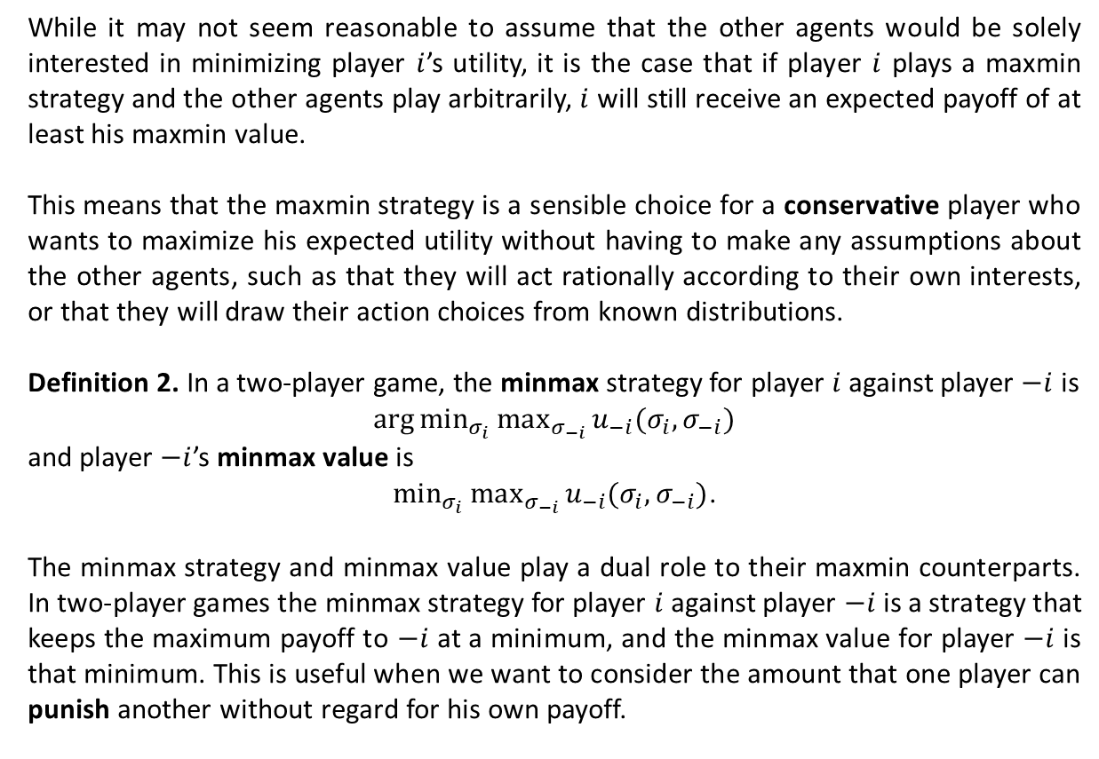
Minmax Strategies in Two-Player Games
While it may not seem reasonable to assume that the other agents would be solely interested in minimizing player $i$’s utility, it is the case that if player $i$ plays a maxmin strategy and the other agents play arbitrarily, $i$ will still receive an expected payoff of at least his maxmin value.
This means that the maxmin strategy is a sensible choice for a conservative player who wants to maximize his expected utility without having to make any assumptions about the other agents, such as that they will act rationally according to their own interests, or that they will draw their action choices from known distributions.
Definition 2. In a two-player game, the minmax strategy for player $i$ against player $−i$ is
$\arg{min_{σ_{i}}{max_{σ_{−i}}{u_{−i}(σ_{i},σ_{−i})}}}$
and player $−i$’s minmax value is
$min_{σ_{i}}{max_{σ_{−i}}{u_{−i}(σ_{i},σ_{−i})}}$.
The minmax strategy and minmax value play a dual role to their maxmin counterparts. In two-player games the minmax strategy for player $i$ against player $−i$ is a strategy that keeps the maximum payoff to $−i$ at a minimum, and the minmax value for player $−i$ is that minimum. This is useful when we want to consider the amount that one player can punish another without regard for his own payoff.

Slide 5
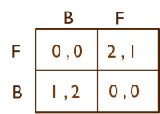
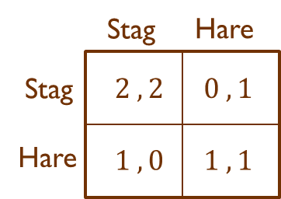



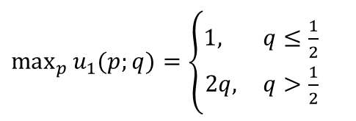

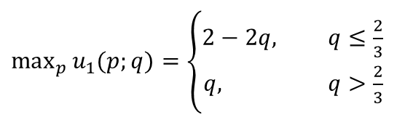




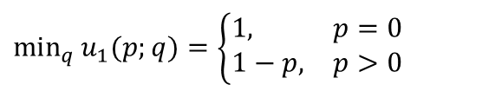










Minmax Strategies in Two-Player Games (Ctd.)
$$q$$
$$1−q$$
Consider the game of the Battle of Sexes. We have
For the game Stag Hunt,
$$p$$
$$u_{1}\left(p;q\right)=2p\left(1−q\right)+\left(1−p\right)q$$
$$=q+\left(2−3q\right)p$$
$$1−p$$
$max_{p}{u_{1}(p;q)}=\left\{\begin{matrix}2−2q, & q≤\frac{2}{3} \\ q, & q>\frac{2}{3}\end{matrix}\right.$
$max_{p}{u_{1}(p;q)}$
$$2$$
$\arg{min_{q}{max_{p}{u_{1}(p;q)}}}=\frac{2}{3}$
$$1$$
${\min_{q}{max}}_{p}{u_{1}(p;q)}=\frac{2}{3}$
$$={\max_{p}{min}}_{q}{u_{1}(p;q)}$$
$$2/3$$
$$1$$
$$q$$
$$q$$
$$1−q$$
$u_{1}\left(p;q\right)=1−p+\left(2p\right)q$.
$$p$$
$min_{q}{u_{1}(p;q)}=\left\{\begin{matrix}1, & p=0 \\ 1−p, & p>0\end{matrix}\right.$
$$1−p$$
$\arg{\max_{p}{\min_{q}{u_{1}(p;q)}}}=0$
$max_{p}{u_{1}(p;q)}=\left\{\begin{matrix}1, & q≤\frac{1}{2} \\ 2q, & q>\frac{1}{2}\end{matrix}\right.$
$max_{p}{min_{q}{u_{1}(p;q)}}=1$
$\arg{min_{q}{max_{p}{u_{1}(p;q)}}}∈[0,\frac{1}{2}]$
$min_{q}{max_{p}{u_{1}(p;q)}}=1$

Slide 6

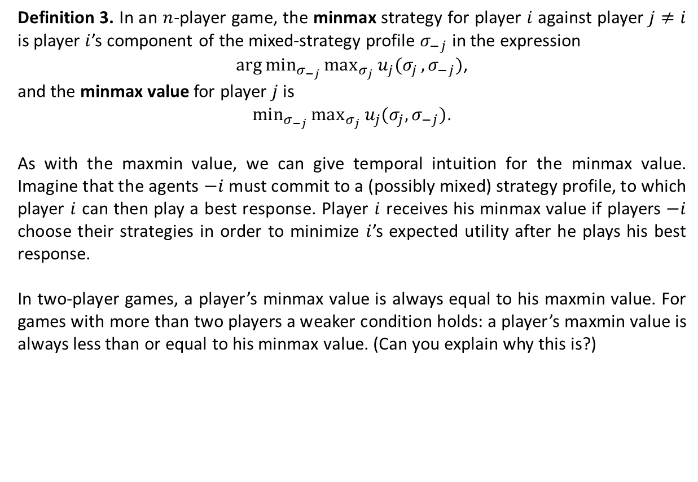






Minmax Strategies in an $n$-Player Game
Definition 3. In an $n$-player game, the minmax strategy for player $i$ against player $j≠i$ is player $i$’s component of the mixed-strategy profile $σ_{−j}$ in the expression
$\arg{min_{σ_{−j}}{max_{σ_{j}}{u_{j}(σ_{j}}}},σ_{−j})$,
and the minmax value for player $j$ is
$min_{σ_{−j}}{max_{σ_{j}}{u_{j}(σ_{j},σ_{−j})}}$.
As with the maxmin value, we can give temporal intuition for the minmax value. Imagine that the agents $−i$ must commit to a (possibly mixed) strategy profile, to which player $i$ can then play a best response. Player $i$ receives his minmax value if players $−i$ choose their strategies in order to minimize $i$’s expected utility after he plays his best response.
In two-player games, a player’s minmax value is always equal to his maxmin value. For games with more than two players a weaker condition holds: a player’s maxmin value is always less than or equal to his minmax value. (Can you explain why this is?)
$$max_{σ_{i}}{min_{σ_{−i}}{u_{i}(σ_{i},σ_{−i})}}$$
$$=$$
$$min_{σ_{−i}}{u_{i}(σ_{i}^{∗},σ_{−i})}$$
$$=$$
$$min_{σ_{−i}}{max_{σ_{i}}{u_{i}(σ_{i},σ_{−i})}}$$
$$≤$$
two-player games

Slide 7
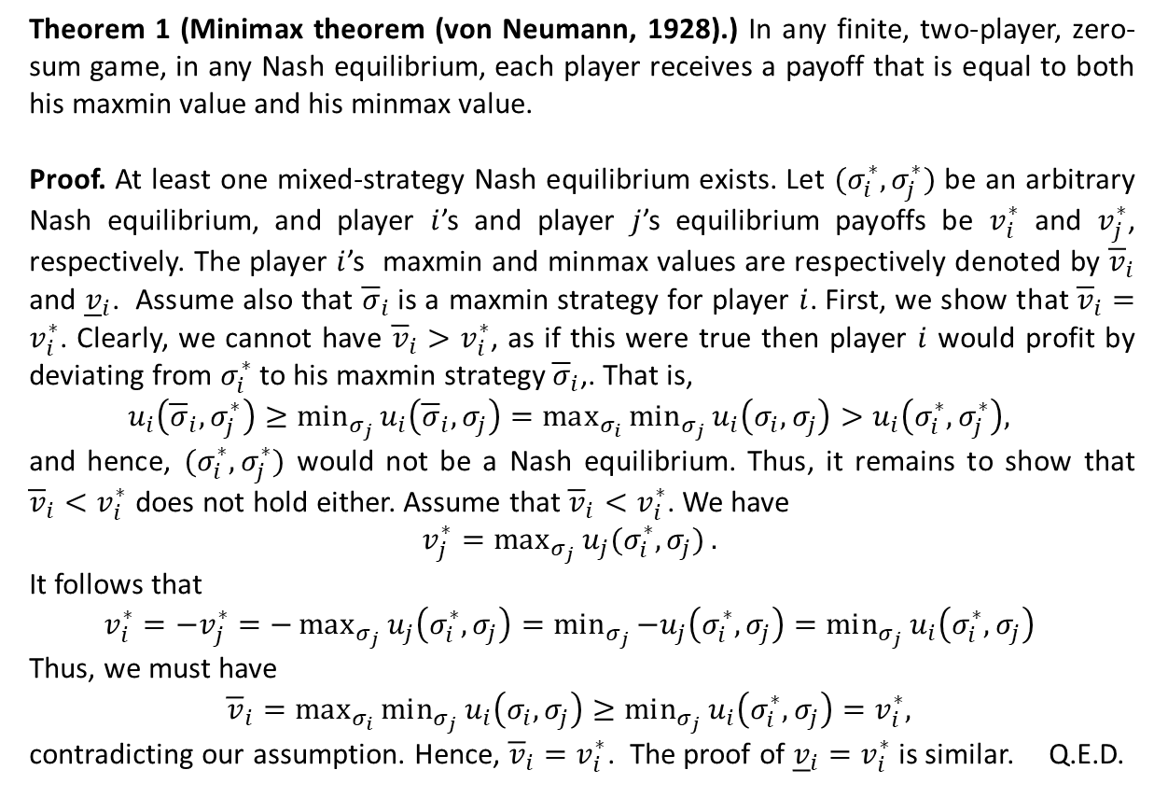
The Minimax Theorem in Two-Player Zero-Sum Games
Theorem 1 (Minimax theorem (von Neumann, 1928).) In any finite, two-player, zero-sum game, in any Nash equilibrium, each player receives a payoff that is equal to both his maxmin value and his minmax value.
Proof. At least one mixed-strategy Nash equilibrium exists. Let $(σ_{i}^{∗},σ_{j}^{∗})$ be an arbitrary Nash equilibrium, and player $i$’s and player $j$’s equilibrium payoffs be $v_{i}^{∗}$ and $v_{j}^{∗}$, respectively. The player $i$’s maxmin and minmax values are respectively denoted by ${\overline{v}}_{i}$ and ${\underline{v}}_{i}$. Assume also that ${\overline{σ}}_{i}$ is a maxmin strategy for player $i$. First, we show that ${\overline{v}}_{i}=v_{i}^{∗}$. Clearly, we cannot have ${\overline{v}}_{i}>v_{i}^{∗}$, as if this were true then player $i$ would profit by deviating from $σ_{i}^{∗}$ to his maxmin strategy ${\overline{σ}}_{i}$,. That is,
$$u_{i}\left({\overline{σ}}_{i},σ_{j}^{∗}\right)≥min_{σ_{j}}{u_{i}\left({\overline{σ}}_{i},σ_{j}\right)=max_{σ_{i}}{min_{σ_{j}}{u_{i}\left(σ_{i},σ_{j}\right)}}}>u_{i}\left(σ_{i}^{∗},σ_{j}^{∗}\right),$$
and hence, $(σ_{i}^{∗},σ_{j}^{∗})$ would not be a Nash equilibrium. Thus, it remains to show that ${\overline{v}}_{i}<v_{i}^{∗}$ does not hold either. Assume that ${\overline{v}}_{i}<v_{i}^{∗}$. We have
$$v_{j}^{∗}=max_{σ_{j}}{u_{j}(σ_{i}^{∗},σ_{j})}.$$
It follows that
$$v_{i}^{∗}=−v_{j}^{∗}=−max_{σ_{j}}{u_{j}\left(σ_{i}^{∗},σ_{j}\right)}=min_{σ_{j}}{−u_{j}\left(σ_{i}^{∗},σ_{j}\right)}=min_{σ_{j}}{u_{i}\left(σ_{i}^{∗},σ_{j}\right)}$$
Thus, we must have
$${\overline{v}}_{i}=max_{σ_{i}}{min_{σ_{j}}{u_{i}\left(σ_{i},σ_{j}\right)}}≥min_{σ_{j}}{u_{i}\left(σ_{i}^{∗},σ_{j}\right)}=v_{i}^{∗},$$
contradicting our assumption. Hence, ${\overline{v}}_{i}=v_{i}^{∗}$. The proof of ${\underline{v}}_{i}=v_{i}^{∗}$ is similar. Q.E.D.

Slide 8
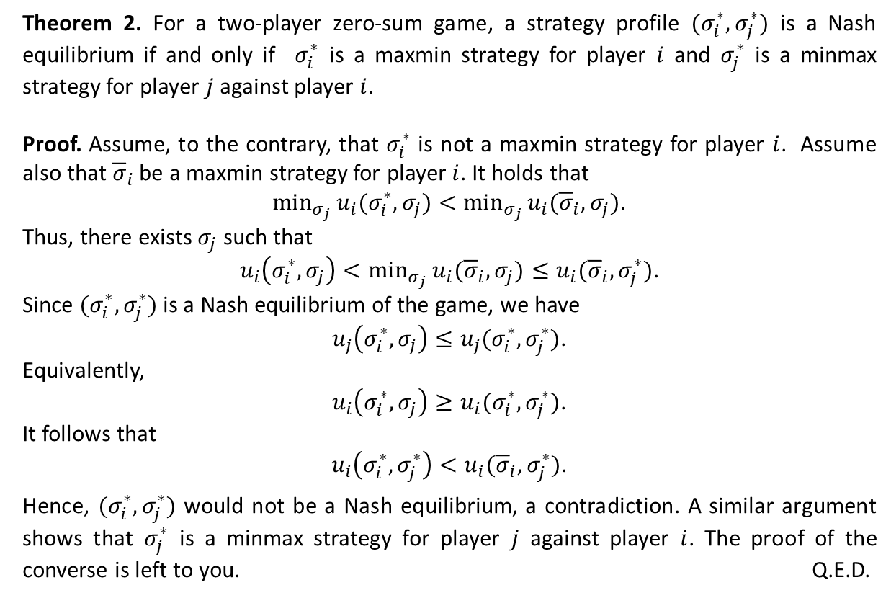
Nash Equilibria in Two-Player Zero-Sum Games
Theorem 2. For a two-player zero-sum game, a strategy profile $(σ_{i}^{∗},σ_{j}^{∗})$ is a Nash equilibrium if and only if $σ_{i}^{∗}$ is a maxmin strategy for player $i$ and $σ_{j}^{∗}$ is a minmax strategy for player $j$ against player $i$.
Proof. Assume, to the contrary, that $σ_{i}^{∗}$ is not a maxmin strategy for player $i$. Assume also that ${\overline{σ}}_{i}$ be a maxmin strategy for player $i$. It holds that
$min_{σ_{j}}{u_{i}(σ_{i}^{∗},σ_{j})}<min_{σ_{j}}{u_{i}({\overline{σ}}_{i},σ_{j})}$.
Thus, there exists $σ_{j}$ such that
$u_{i}\left(σ_{i}^{∗},σ_{j}\right)<min_{σ_{j}}{u_{i}({\overline{σ}}_{i},σ_{j})}≤u_{i}({\overline{σ}}_{i},σ_{j}^{∗})$.
Since $(σ_{i}^{∗},σ_{j}^{∗})$ is a Nash equilibrium of the game, we have
$u_{j}\left(σ_{i}^{∗},σ_{j}\right)≤u_{j}(σ_{i}^{∗},σ_{j}^{∗})$.
Equivalently,
$u_{i}\left(σ_{i}^{∗},σ_{j}\right)≥u_{i}(σ_{i}^{∗},σ_{j}^{∗})$.
It follows that
$u_{i}\left(σ_{i}^{∗},σ_{j}^{∗}\right)<u_{i}({\overline{σ}}_{i},σ_{j}^{∗})$.
Hence, $(σ_{i}^{∗},σ_{j}^{∗})$ would not be a Nash equilibrium, a contradiction. A similar argument shows that $σ_{j}^{∗}$ is a minmax strategy for player $j$ against player $i$. The proof of the converse is left to you. Q.E.D.

Slide 9
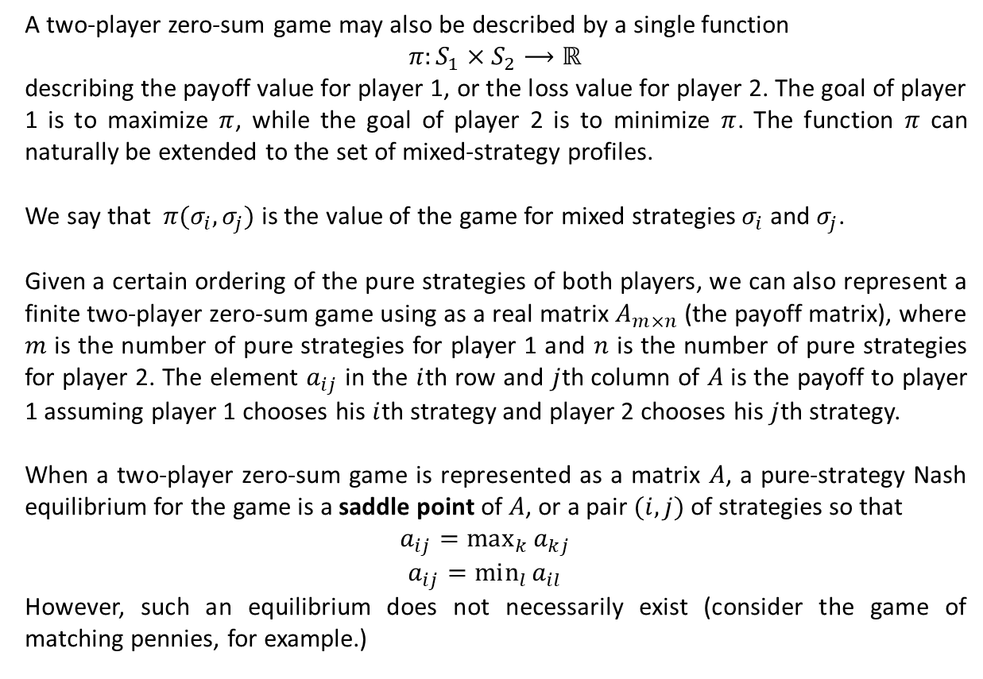
Nash Equilibria in Two-Player Zero-Sum Games (Ctd.)
A two-player zero-sum game may also be described by a single function
$π:S_{1}×S_{2}⟶ℝ$
describing the payoff value for player 1, or the loss value for player 2. The goal of player 1 is to maximize $π$, while the goal of player 2 is to minimize $π$. The function $π$ can naturally be extended to the set of mixed-strategy profiles.
We say that $π(σ_{i},σ_{j})$ is the value of the game for mixed strategies $σ_{i}$ and $σ_{j}$.
Given a certain ordering of the pure strategies of both players, we can also represent a finite two-player zero-sum game using as a real matrix $A_{m×n}$ (the payoff matrix), where $m$ is the number of pure strategies for player 1 and $n$ is the number of pure strategies for player 2. The element $a_{ij}$ in the $i$th row and $j$th column of $A$ is the payoff to player 1 assuming player 1 chooses his $i$th strategy and player 2 chooses his $j$th strategy.
When a two-player zero-sum game is represented as a matrix $A$, a pure-strategy Nash equilibrium for the game is a saddle point of $A$, or a pair $(i,j)$ of strategies so that
$$a_{ij}=max_{k}{a_{kj}}$$
$$a_{ij}=min_{l}{a_{il}}$$
However, such an equilibrium does not necessarily exist (consider the game of matching pennies, for example.)

Slide 10
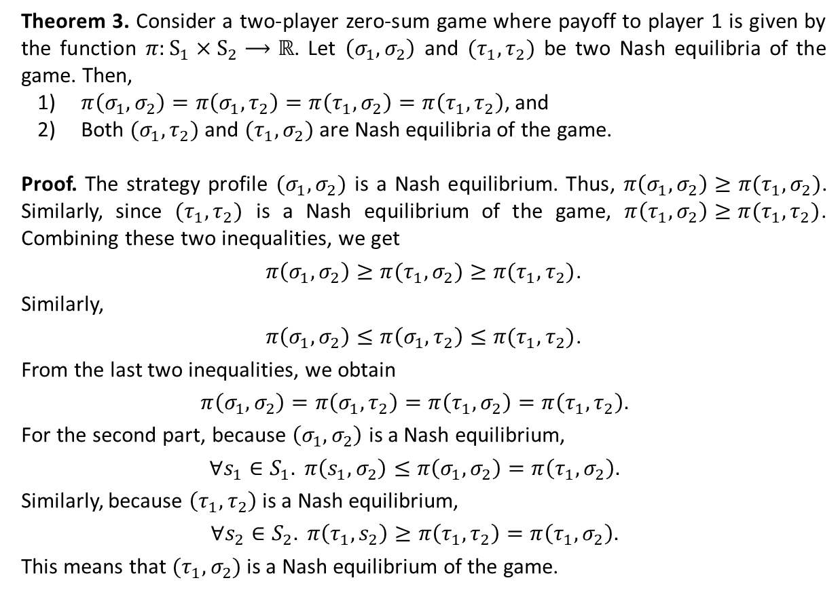
Nash Equilibria in Two-Player Zero-Sum Games (Ctd.)
Theorem 3. Consider a two-player zero-sum game where payoff to player 1 is given by the function $π:S_{1}×S_{2}⟶ℝ$. Let $\left(σ_{1},σ_{2}\right)$ and $(τ_{1},τ_{2})$ be two Nash equilibria of the game. Then,
$π\left(σ_{1},σ_{2}\right)=π\left(σ_{1},τ_{2}\right)=π\left(τ_{1},σ_{2}\right)=π\left(τ_{1},τ_{2}\right)$, and
Both $(σ_{1},τ_{2})$ and $(τ_{1},σ_{2})$ are Nash equilibria of the game.
Proof. The strategy profile $(σ_{1},σ_{2})$ is a Nash equilibrium. Thus, $π\left(σ_{1},σ_{2}\right)≥π(τ_{1},σ_{2})$. Similarly, since $(τ_{1},τ_{2})$ is a Nash equilibrium of the game, $π\left(τ_{1},σ_{2}\right)≥π(τ_{1},τ_{2})$. Combining these two inequalities, we get
$π\left(σ_{1},σ_{2}\right)≥π(τ_{1},σ_{2})≥π(τ_{1},τ_{2})$.
Similarly,
$π\left(σ_{1},σ_{2}\right)≤π\left(σ_{1},τ_{2}\right)≤π(τ_{1},τ_{2})$.
From the last two inequalities, we obtain
$$π\left(σ_{1},σ_{2}\right)=π\left(σ_{1},τ_{2}\right)=π\left(τ_{1},σ_{2}\right)=π\left(τ_{1},τ_{2}\right).$$
For the second part, because $\left(σ_{1},σ_{2}\right)$ is a Nash equilibrium,
$$∀s_{1}∈S_{1}. π\left(s_{1},σ_{2}\right)≤π\left(σ_{1},σ_{2}\right)=π\left(τ_{1},σ_{2}\right).$$
Similarly, because $\left(τ_{1},τ_{2}\right)$ is a Nash equilibrium,
$$∀s_{2}∈S_{2}. π\left(τ_{1},s_{2}\right)≥π\left(τ_{1},τ_{2}\right)=π\left(τ_{1},σ_{2}\right).$$
This means that $(τ_{1},σ_{2})$ is a Nash equilibrium of the game.

Slide 11
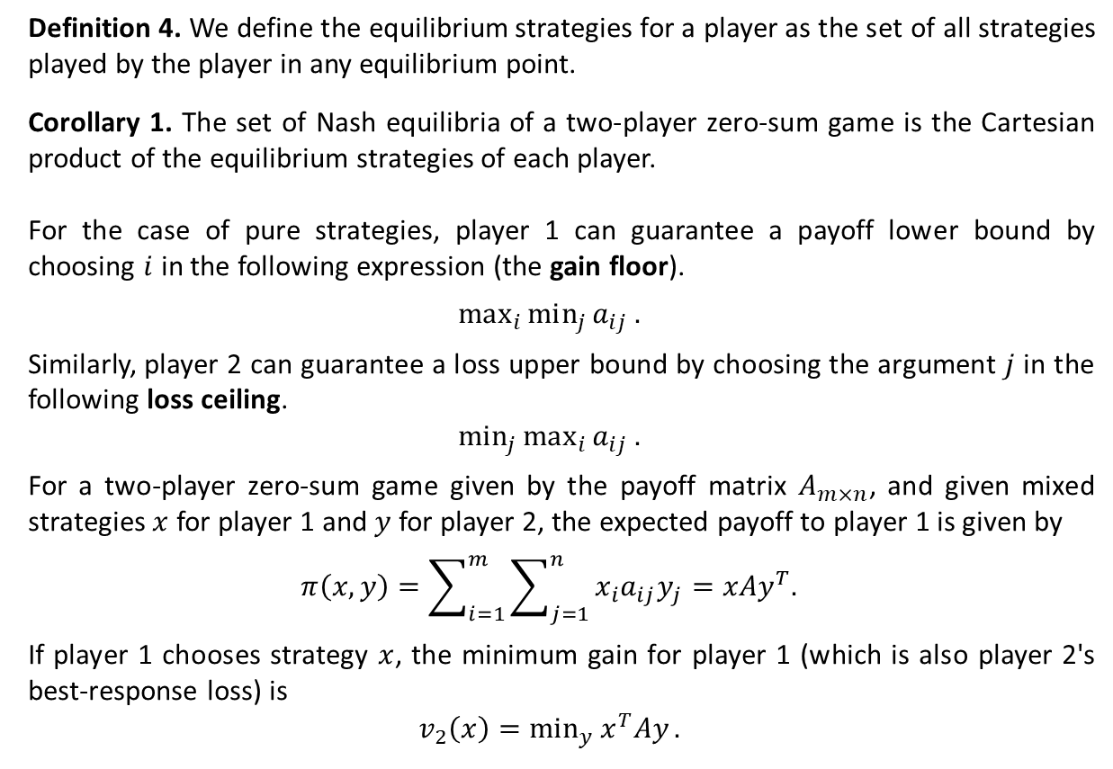
Computing Maxmin and Minmax Strategies
Definition 4. We define the equilibrium strategies for a player as the set of all strategies played by the player in any equilibrium point.
Corollary 1. The set of Nash equilibria of a two-player zero-sum game is the Cartesian product of the equilibrium strategies of each player.
For the case of pure strategies, player 1 can guarantee a payoff lower bound by choosing $i$ in the following expression (the gain floor).
$$max_{i}{min_{j}{a_{ij}}}.$$
Similarly, player 2 can guarantee a loss upper bound by choosing the argument $j$ in the following loss ceiling.
$$min_{j}{max_{i}{a_{ij}}}.$$
For a two-player zero-sum game given by the payoff matrix $A_{m×n}$, and given mixed strategies $x$ for player 1 and $y$ for player 2, the expected payoff to player 1 is given by
$$π\left(x,y\right)=\sum_{i=1}^{m}{\sum_{j=1}^{n}{x_{i}a_{ij}y_{j}}}=xAy^{T}.$$
If player 1 chooses strategy $x$, the minimum gain for player 1 (which is also player 2's best-response loss) is
$$v_{2}\left(x\right)=min_{y}{x^{T}Ay}.$$

Slide 12
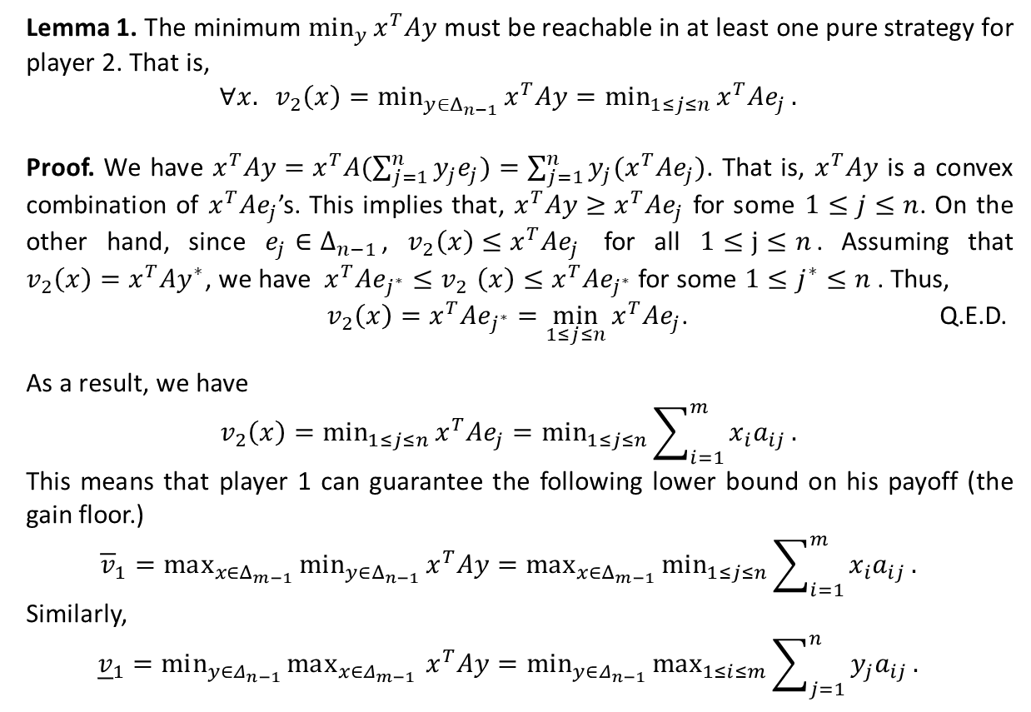
Computing Maxmin and Minmax Strategies (Ctd.)
Lemma 1. The minimum $min_{y}{x^{T}Ay}$ must be reachable in at least one pure strategy for player 2. That is,
$$∀x. v_{2}\left(x\right)=min_{y∈Δ_{n−1}}{x^{T}Ay=min_{1≤j≤n}{x^{T}Ae_{j}}}.$$
Proof. We have $x^{T}Ay=x^{T}A(\sum_{j=1}^{n}{y_{j}e_{j})}=\sum_{j=1}^{n}{y_{j}(x^{T}Ae_{j})}$. That is, $x^{T}Ay$ is a convex combination of $x^{T}Ae_{j}$’s. This implies that, $x^{T}Ay≥x^{T}Ae_{j}$ for some $1≤j≤n$. On the other hand, since $e_{j}∈Δ_{n−1}$, $v_{2}\left(x\right)≤x^{T}Ae_{j}$ for all $1≤j≤n$. Assuming that $v_{2}\left(x\right)=x^{T}Ay^{∗}$, we have $x^{T}Ae_{j^{∗}}{≤v}_{2}\left(x\right)≤x^{T}Ae_{j^{∗}}$ for some $1≤j^{∗}≤n$ . Thus,
$v_{2}\left(x\right)=x^{T}Ae_{j^{∗}}=\min_{1≤j≤n}{x^{T}Ae_{j}}$. Q.E.D.
As a result, we have
$$v_{2}\left(x\right)=min_{1≤j≤n}{x^{T}Ae_{j}}=min_{1≤j≤n}{\sum_{i=1}^{m}{x_{i}a_{ij}}}.$$
This means that player 1 can guarantee the following lower bound on his payoff (the gain floor.)
$${\overline{v}}_{1}=max_{x∈Δ_{m−1}}{min_{y∈Δ_{n−1}}{x^{T}Ay}}=max_{x∈Δ_{m−1}}{min_{1≤j≤n}{\sum_{i=1}^{m}{x_{i}a_{ij}}}}.$$
Similarly,
$${\underline{v}}_{1}=min_{y∈Δ_{n−1}}{max_{x∈Δ_{m−1} }{x^{T}Ay}}=min_{y∈Δ_{n−1}}{max_{1≤i≤m}{\sum_{j=1}^{n}{y_{j}a_{ij}}}}.$$

Slide 13
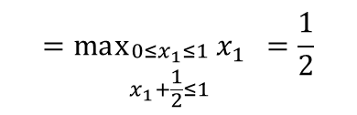
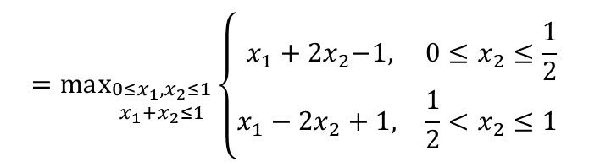

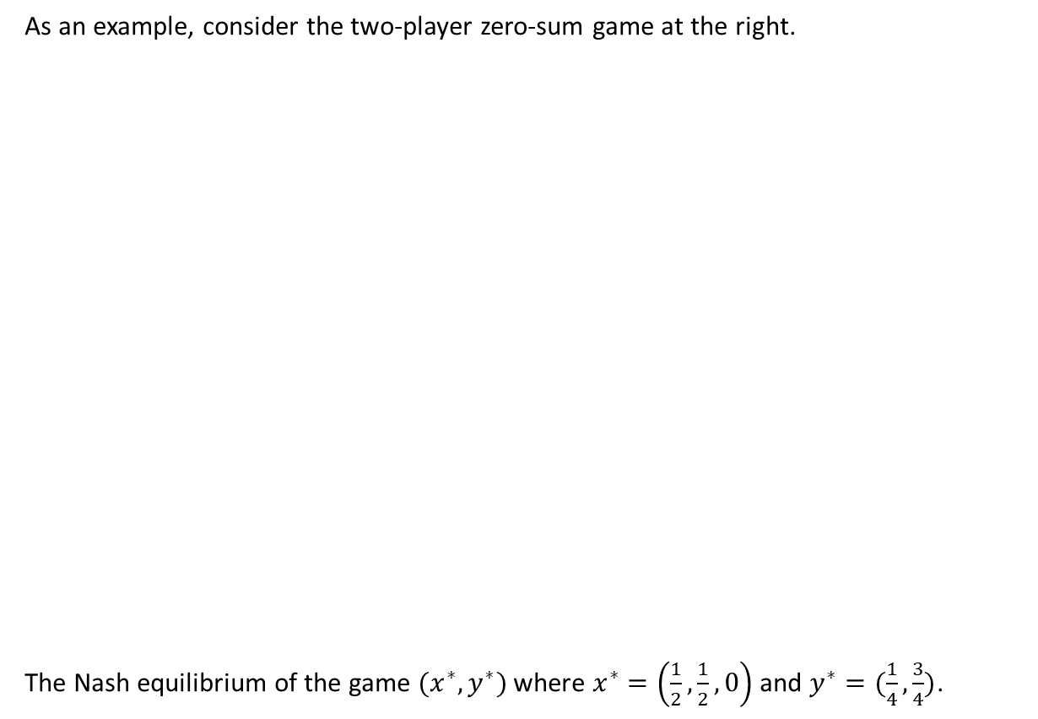


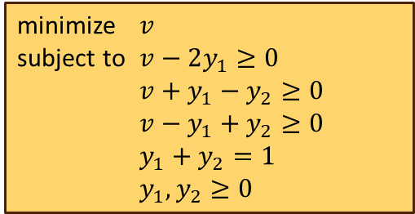
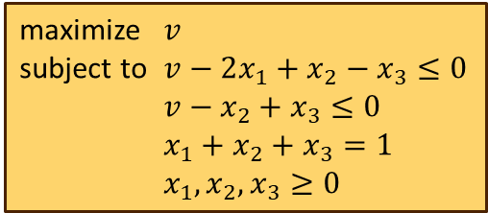
Computing Maxmin and Minmax Strategies (Ctd.)
As an example, consider the two-player zero-sum game at the right.
The Nash equilibrium of the game $(x^{∗},y^{∗})$ where $x^{∗}=\left(\frac{1}{2},\frac{1}{2},0\right)$ and $y^{∗}=(\frac{1}{4},\frac{3}{4})$.
L
R
$${\overline{v}}_{1}=max_{x∈Δ_{2}}{\min{ \{2x_{1}−x_{2}+x_{3},{ x}_{2}−x_{3}\} }}$$
U
2, -2
0, 0
$$=max_{\begin{aligned}0≤x_{1},x_{2}≤1 \\ x_{1}+x_{2}≤1\end{aligned}}{\min{ \{x_{1}−{2x}_{2}+1,{ x_{1}+2x}_{2}−1\} }}$$
M
-1, 1
1, -1
$$=max_{\begin{aligned}0≤x_{1},x_{2}≤1 \\ x_{1}+x_{2}≤1\end{aligned}}\left\{\begin{matrix}{ x_{1}+2x}_{2}−1, & {0≤x}_{2}≤\frac{1}{2} \\ x_{1}−{2x}_{2}+1, & \frac{1}{2}<x_{2}≤1\end{matrix}\right.{ }$$
D
1, -1
-1, 1
$$=max_{\begin{aligned}0≤x_{1}≤1 \\ x_{1}+\frac{1}{2}≤1\end{aligned}}{x_{1}{ }}=\frac{1}{2}$$
A linear program for the maxmin value
A linear program for the minmax value
maximize $v$
subject to $v−2x_{1}+x_{2}−x_{3}≤0$
$v−x_{2}+x_{3}≤0$
$x_{1}+x_{2}+x_{3}=1$
$x_{1},x_{2},x_{3}≥0$
minimize $v$
subject to $v−2y_{1}≥0$
$v+y_{1}−y_{2}≥0$
$v−y_{1}+y_{2}≥0$
$y_{1}+y_{2}=1$
$y_{1},y_{2}≥0$
$$v=0.5, x_{1}=0.5, x_{2}=0.5, x_{3}=0.0$$
$$v=0.5, y_{1}=0.25, y_{2}=0.75$$

Slide 14
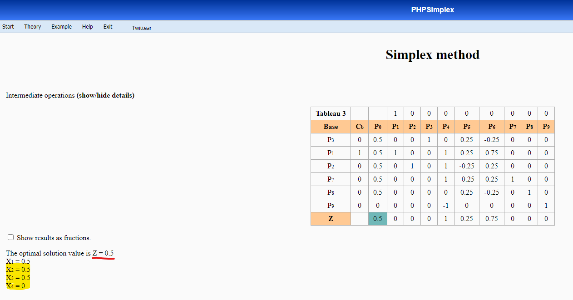
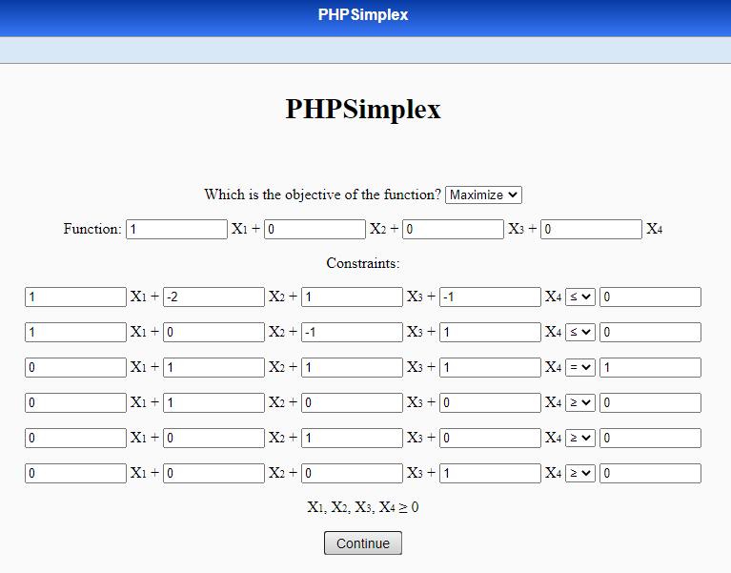
Computing Maxmin and Minmax Strategies (Ctd.)

Slide 15
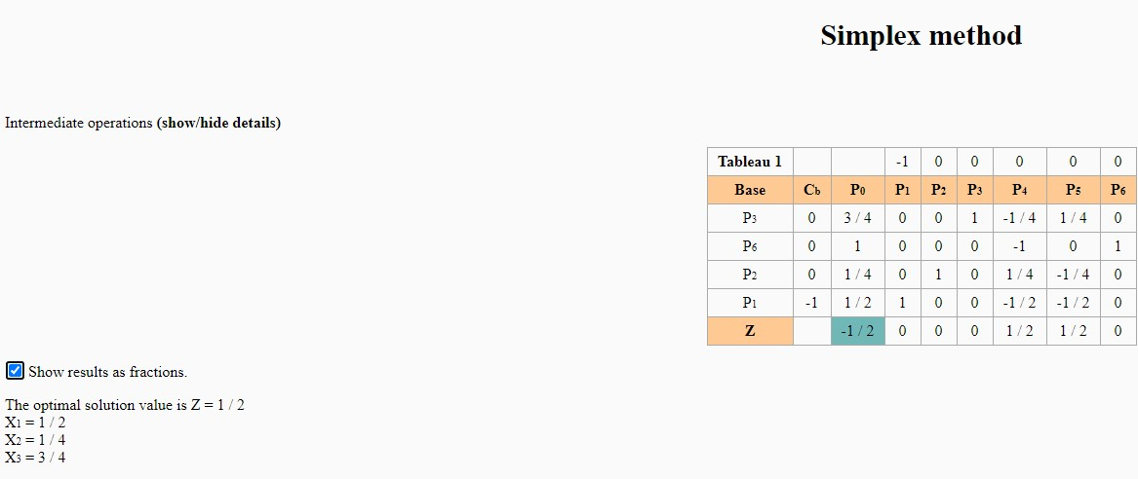
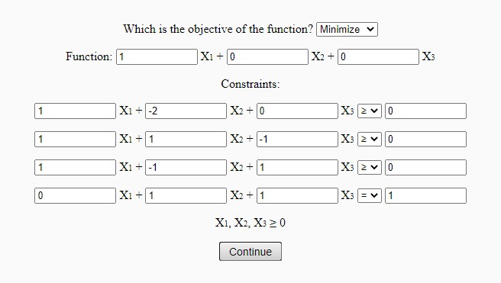

Computing Maxmin and Minmax Strategies (Ctd.)

Slide 16

Computing Maxmin and Minmax Strategies (Ctd.)

Slide 17
You can get the slides at http://courses.aut.ac.ir.

